Slide 1


Slide 2

PROPHET
TIME SERIES
CHICAGO
CRIME RATE

Slide 3
PROPHET
TIME SERIES
PROBLEM STATEMENT

Slide 4
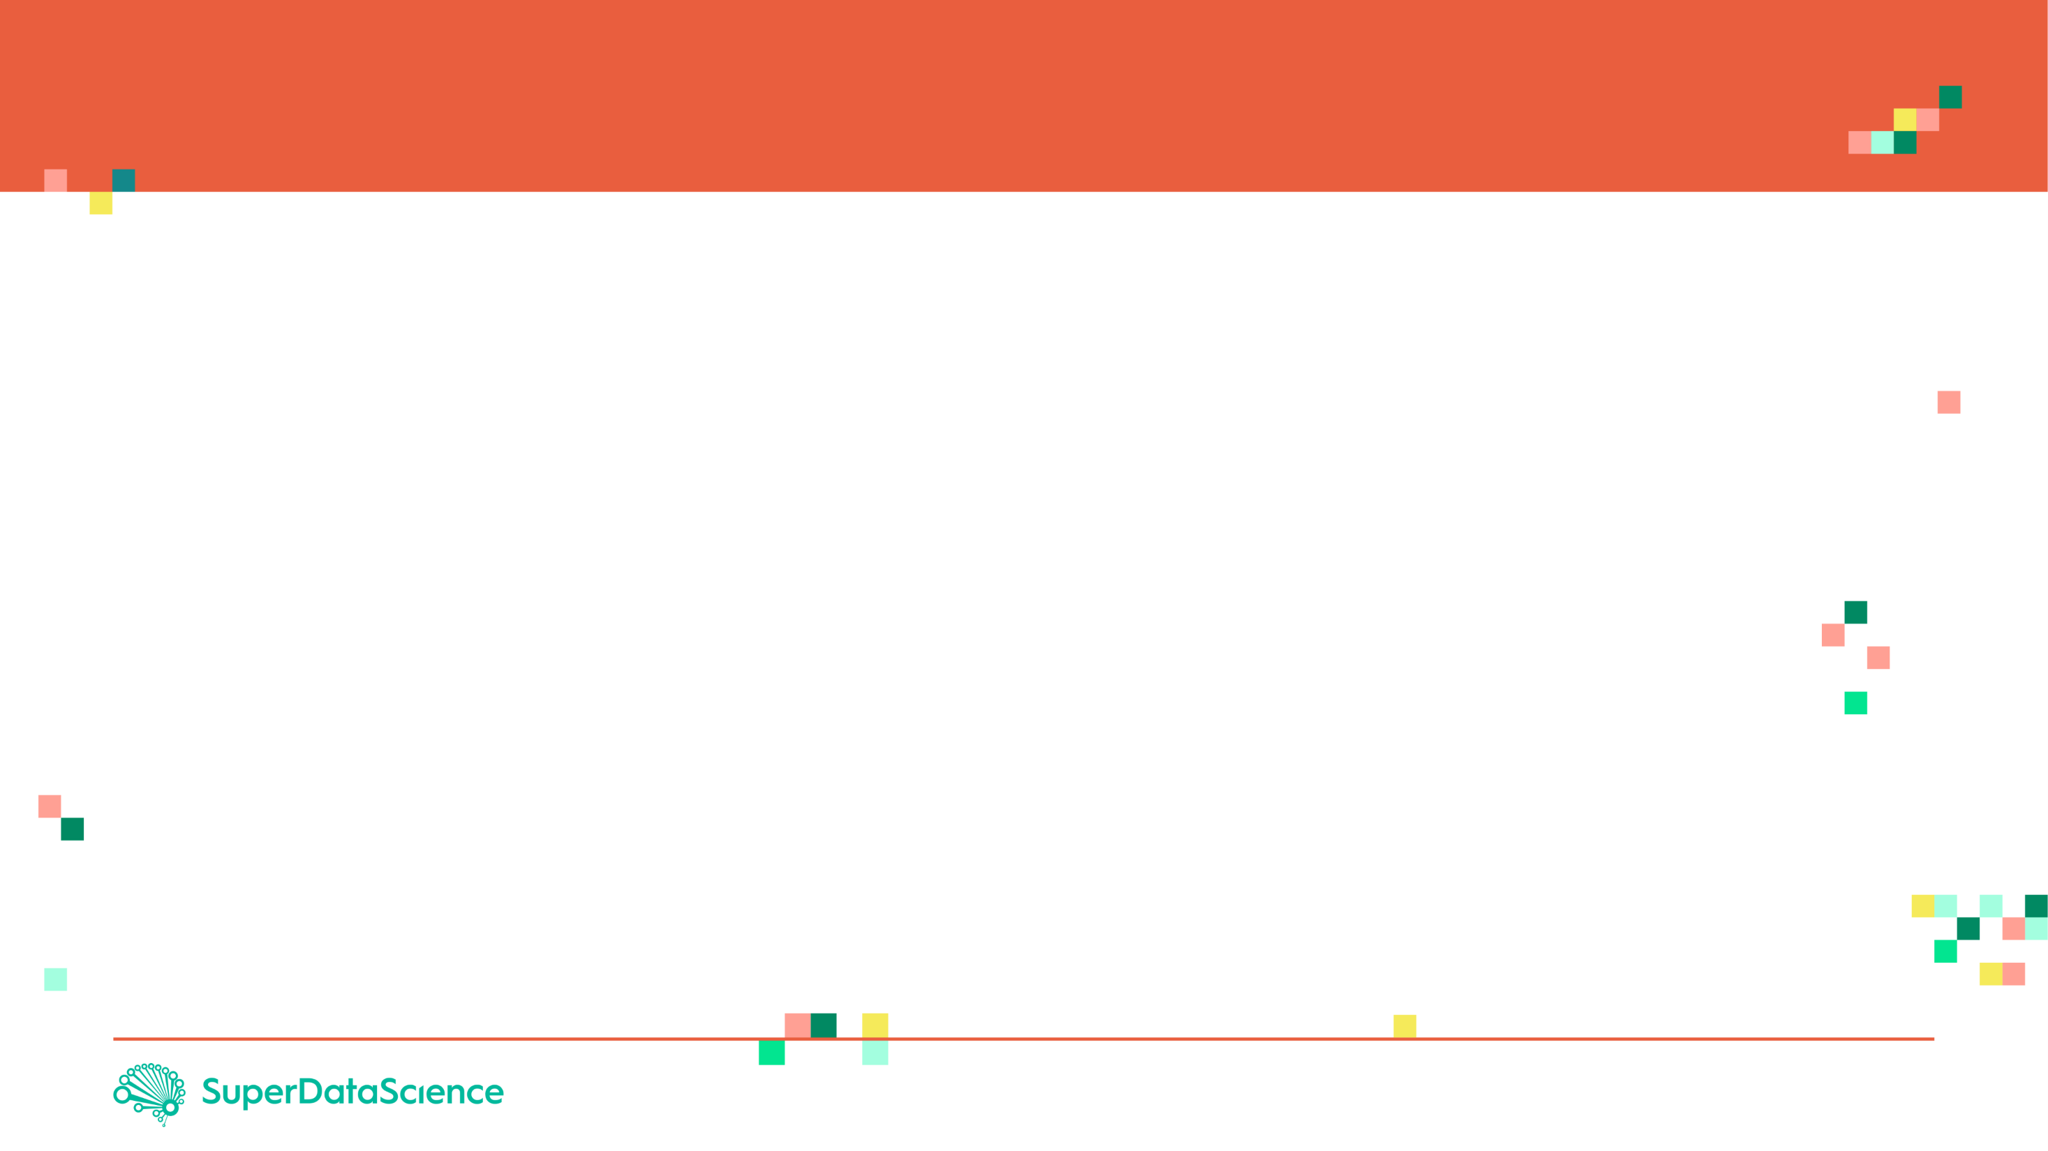
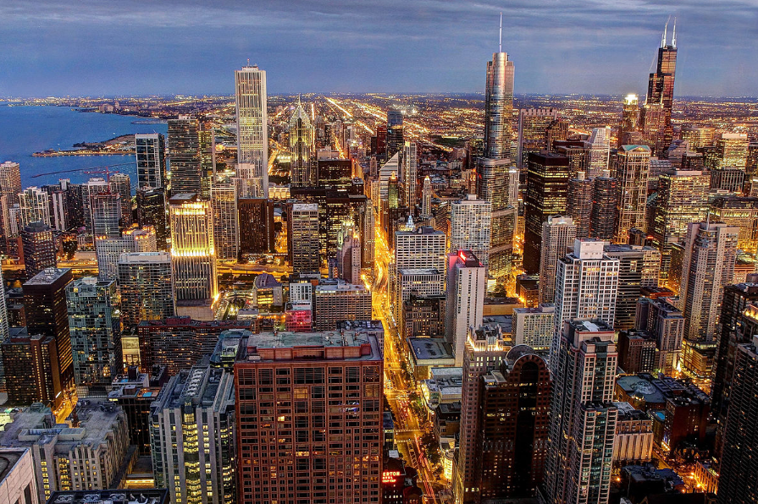
PROJECT OVERVIEW
The Chicago Crime dataset contains a summary of the reported crimes occurred in the City of Chicago from 2001 to 2017.
Dataset has been obtained from the Chicago Police Department's CLEAR (Citizen Law Enforcement Analysis and Reporting) system.
Dataset contains the following columns:
ID: Unique identifier for the record.
Case Number: The Chicago Police Department RD Number (Records Division Number), which is unique to the incident.
Date: Date when the incident occurred.
Block: address where the incident occurred
IUCR: The Illinois Uniform Crime Reporting code.
Primary Type: The primary description of the IUCR code.
Description: The secondary description of the IUCR code, a subcategory of the primary description.
Image Source: https://commons.wikimedia.org/wiki/File:Chicago_skyline,_viewed_from_John_Hancock_Center.jpg
Datasource: https://www.kaggle.com/currie32/crimes-in-chicago

Slide 5
PROJECT OVERVIEW
Location Description: Description of the location where the incident occurred.
Arrest: Indicates whether an arrest was made.
Domestic: Indicates whether the incident was domestic-related as defined by the Illinois Domestic Violence Act.
Beat: Indicates the beat where the incident occurred. A beat is the smallest police geographic area – each beat has a dedicated police beat car.
District: Indicates police district where the incident occurred.
Ward: The ward (City Council district) where incident occurred.
Community Area: Indicates the community area where the incident occurred. Chicago has 77 community areas.
FBI Code: Indicates the crime classification as outlined in the FBI's National Incident-Based Reporting System (NIBRS).
Image Source: https://commons.wikimedia.org/wiki/File:Chicago_skyline,_viewed_from_John_Hancock_Center.jpg
Datasource: https://www.kaggle.com/currie32/crimes-in-chicago

Slide 6
PROJECT OVERVIEW
X Coordinate: The x coordinate of the location where the incident occurred in State of Illinois.
Y Coordinate: The y coordinate of the location where the incident occurred in State of Illinois.
Year: Year the incident occurred.
Updated On: Date and time the record was last updated.
Latitude: The latitude of the location where the incident occurred. This location is shifted from the actual location for partial redaction but falls on the same block.
Longitude: The longitude of the location where the incident occurred. This location is shifted from the actual location for partial redaction but falls on the same block.
Location: The location where the incident occurred
Image Source: https://commons.wikimedia.org/wiki/File:Chicago_skyline,_viewed_from_John_Hancock_Center.jpg
Datasource: https://www.kaggle.com/currie32/crimes-in-chicago

Slide 7

WHAT IS FACEBOOK PROPHET?

Slide 8
FACEBOOK PROPHET
Prophet is open source software released by Facebook’s Core Data Science team.
Prophet is a procedure for forecasting time series data based on an additive model where non-linear trends are fit with yearly, weekly, and daily seasonality, plus holiday effects.
Prophet works best with time series that have strong seasonal effects and several seasons of historical data.
For more information, please check this out:
https://research.fb.com/prophet-forecasting-at-scale/
https://facebook.github.io/prophet/docs/quick_start.html#python-api
NOTE:
You must install fbprophet package as follows: pip install fbprophet
If you encounter an error, try: conda install -c conda-forge fbprophet

Slide 9

FACEBOOK PROPHET
Prophet implements an additive regression model with four elements:
A piecewise linear, Prophet automatically picks up change points in the data and identifies any change in trends.
A yearly seasonal component modeled using Fourier series.
A weekly seasonal component.
A holiday list that can be manually provided.
Additive Regression model takes the form:
$$Y=β_{0}+\sum_{j=1}^{p}{f_{j}\left(X_{j}\right)+ε}$$
The functions $f_{j}(x_{j})$ are unknown smoothing functions fit from the data
Reference: https://research.fb.com/prophet-forecasting-at-scale/

Slide 10
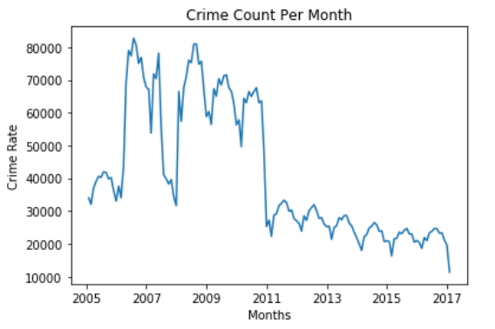
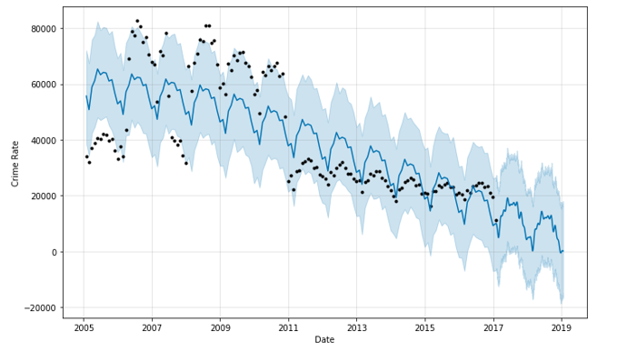
FACEBOOK PROPHET EXPECTED OUTPUT
FACEBOOK PROPHET

Slide 11
FACEBOOK PROPHET EXPECTED OUTPUT
Expected Outcome:
FUTURE
PAST

Slide 12
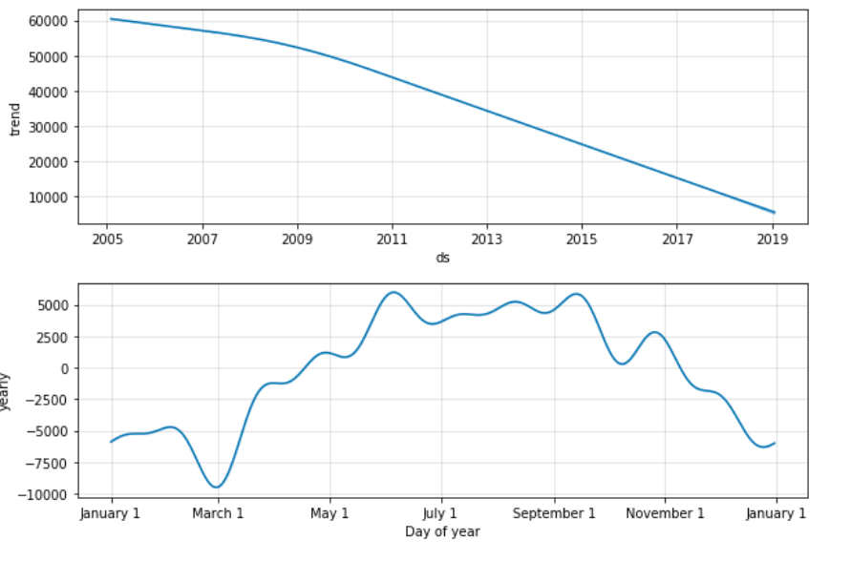
FACEBOOK PROPHET EXPECTED OUTPUT

